Slide 1
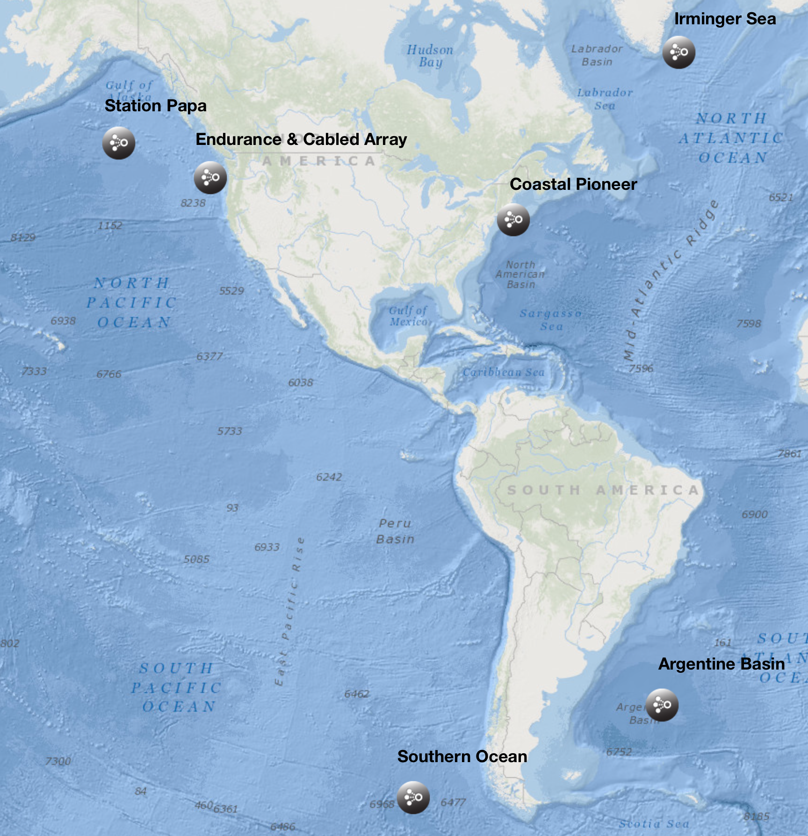
Designing Educational Visualizations
Sage Lichtenwalner
Rutgers University
www.oceanobservatories.org

Slide 2
My Background
Science
Data Collection
Visualization
Data Analysis
Education
Pedagogy
Curriculum Design
User Experience Design

Slide 3
Design Processes
Problems
Insights
Solutions
Design
Build
Test

Slide 4
What happens next?
A Documentary

Slide 5


Slide 6
What is “Visualization”?
Visual Analysis
Data Visualization
Info Aesthetics
Information Design
Visual Analytics
Explorative Visualization
Visualization
Infographics
Information Visualization
(InfoVis)
Information Art
Charting
Data Art
Bioinformatics
Infoporn
Mapping
Cartography
Chart Junk
Pragmatic Visualization
Graphing
Scientific Illustration
Artistic Visualization
“Visual analysis is not primarily about the pictures, but about finding ways to use our powerful visual systems to analyze data. It's analysis done in a visual way. It's visual exploration, visual data analysis, and visual presentation of results.”
Robert Kosara, eagereyes.org

Slide 7
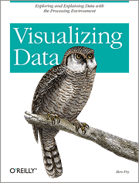
Visualization Design Process
Ben Fry’s seven stages to visualize data
Acquire
Parse
Filter
Mine
Represent
Refine
Interact

Slide 8
Visualizing Data – The Process
Acquire
Obtain the data, whether from a file on a disk or a source over a network
Parse
Provide some structure for the data’s meaning, and order it into categories.
Filter
Remove all but the data of interest.
Mine
Apply methods from statistics or data mining as a way to discern patterns or place the data in mathematical context.
Represent
Choose a basic visual model, such as a bar graph, list or tree.
Refine
Improve the basic representation to make it clearer and more visually engaging.
Interact
Add methods for manipulating the data or controlling what features are visible.
From Visualizing Data (2008), by Ben Fry.

Slide 9
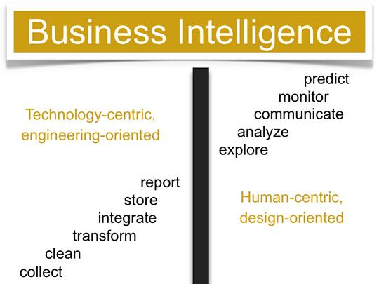
Are we stuck on the left?
https://www.perceptualedge.com/blog/?p=820

Slide 10
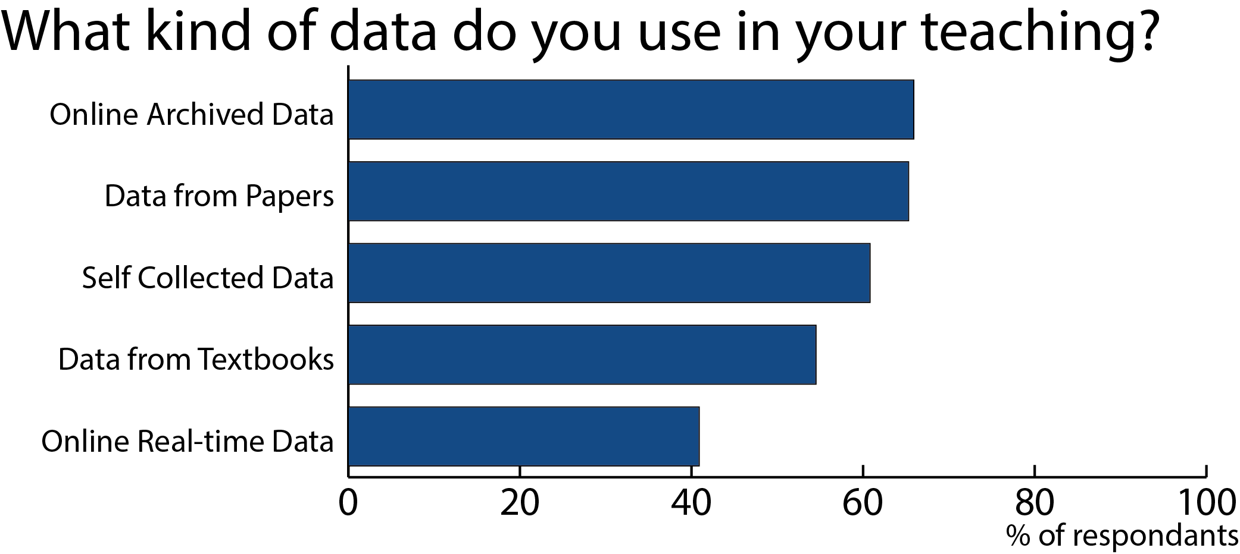
2012 Undergraduate Educator Survey

Slide 11
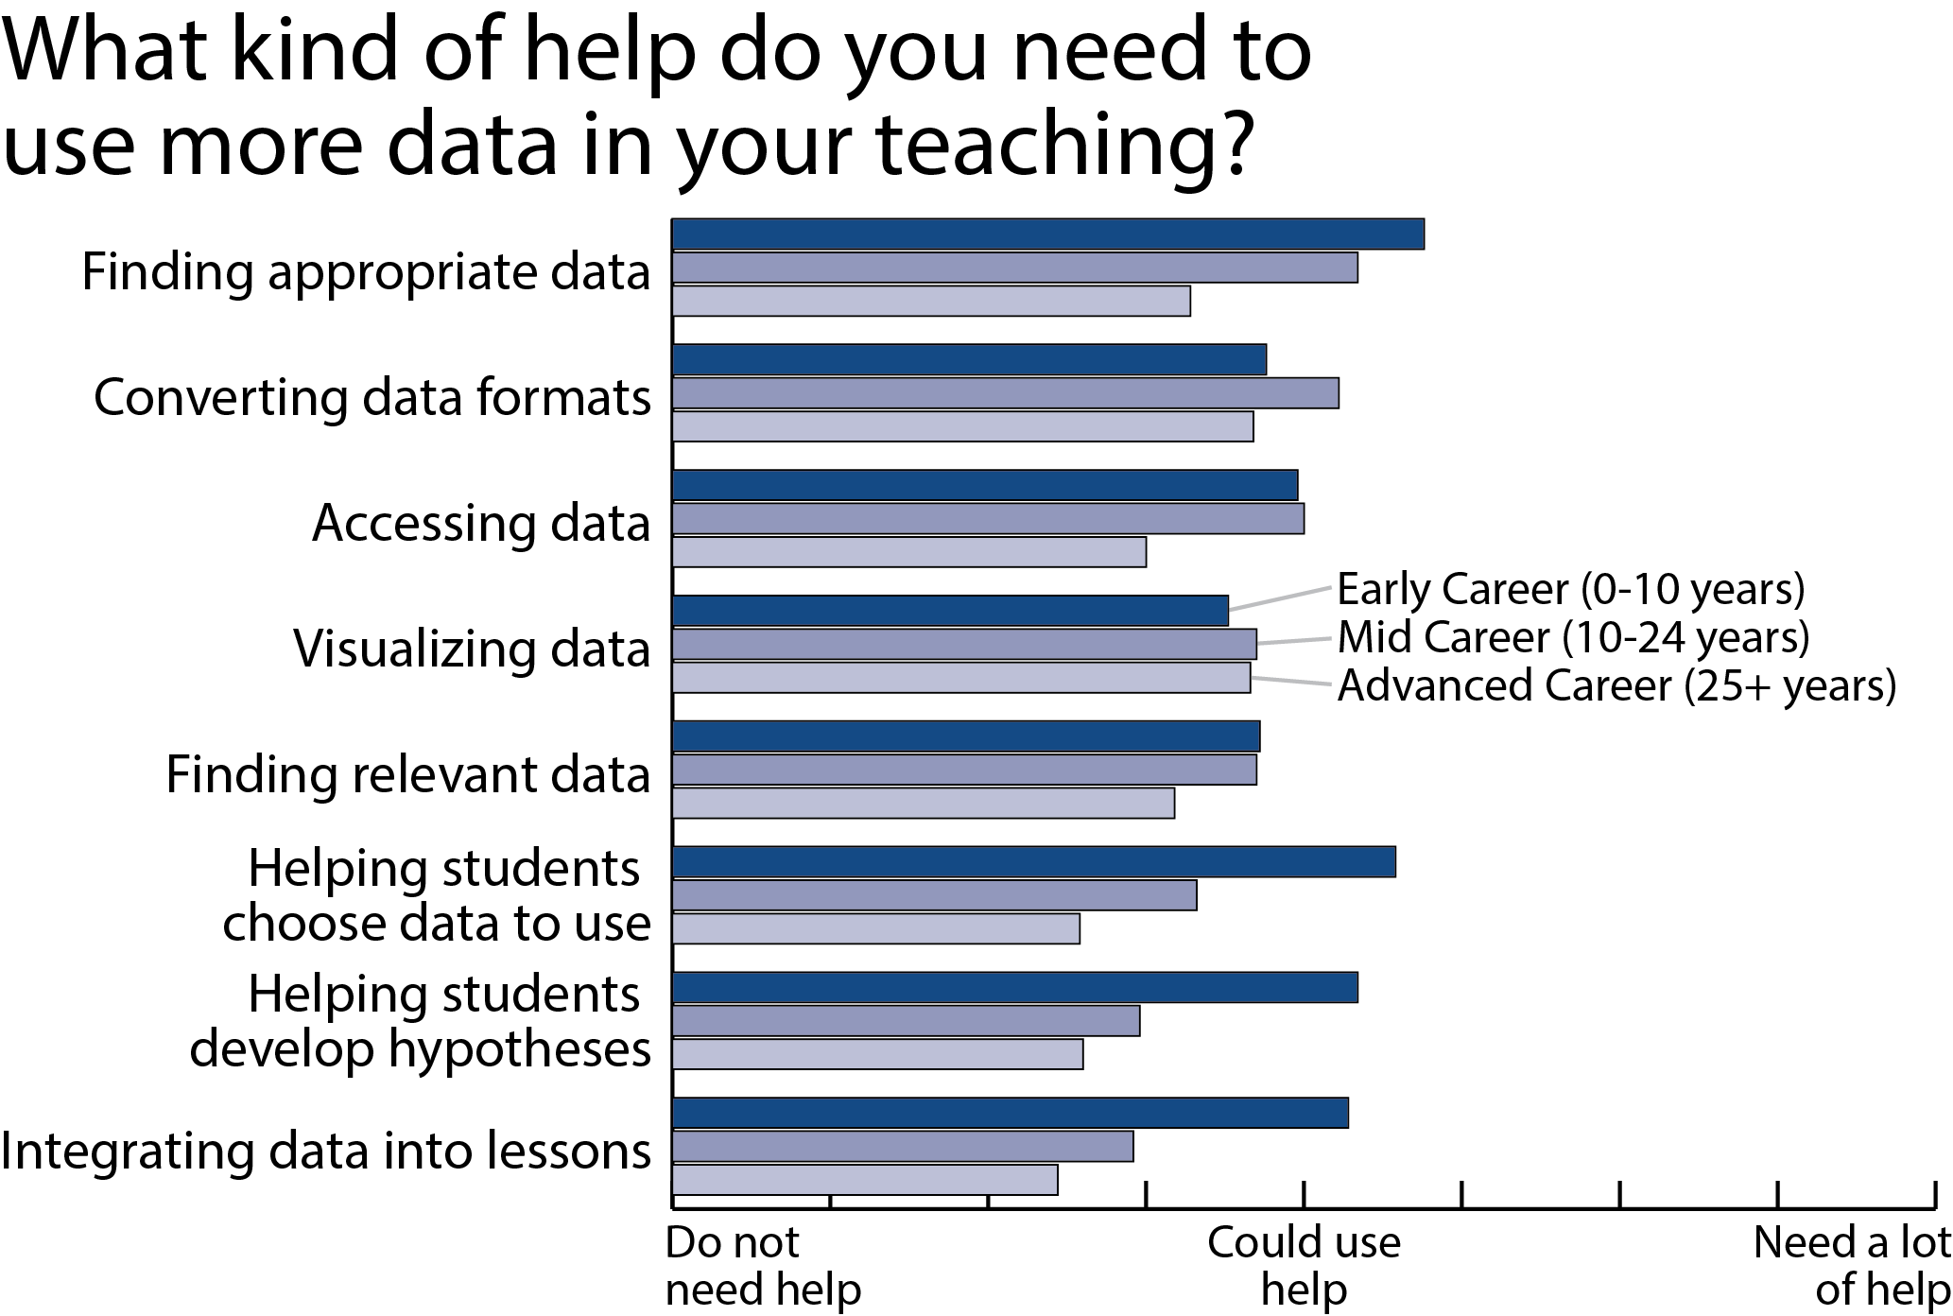
2012 Undergraduate Educator Survey

Slide 12
Your Data Needs
Concepts
Skills
Datasets
Analyses

Slide 13
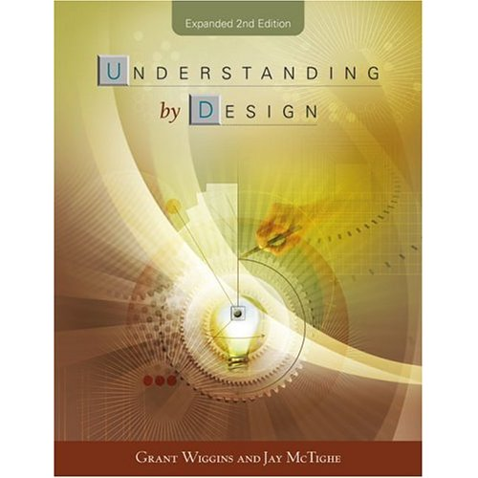
Design Frameworks: Backwards Design (Understanding by Design – Wiggins & McTighe, 1998)
Driven by end goals- what we want students to be able to do (performance oriented)
Strength is in the focus on creating greater coherence and alignment between goals, learning experiences, and assessments

Slide 14
Design Frameworks: Backwards Design (Understanding by Design – Wiggins & McTighe, 1998)
Determine enduring understandings:
Few core ideas as enduring (3-5)
Filters- big idea; at heart of domain; requires un-coverage; engaging
Evidence:
Ongoing assessment (formative) not just at the end; formal and informal; performance oriented
Valid, reliable, authentic, feasible
Learning experiences:
What is the enabling knowledge?
Match learning goals to activities
Provide scaffolding
Coherent and goal oriented for students

Slide 15
FIN

Slide 17
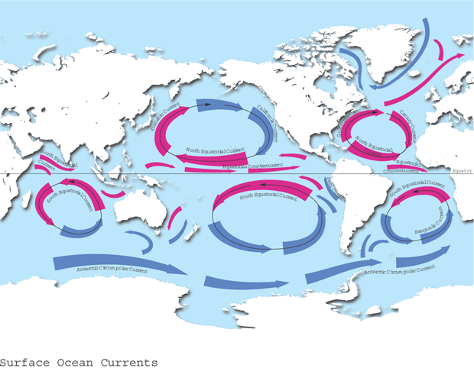
This is what we teach – 5 Ocean Gyres

Slide 18
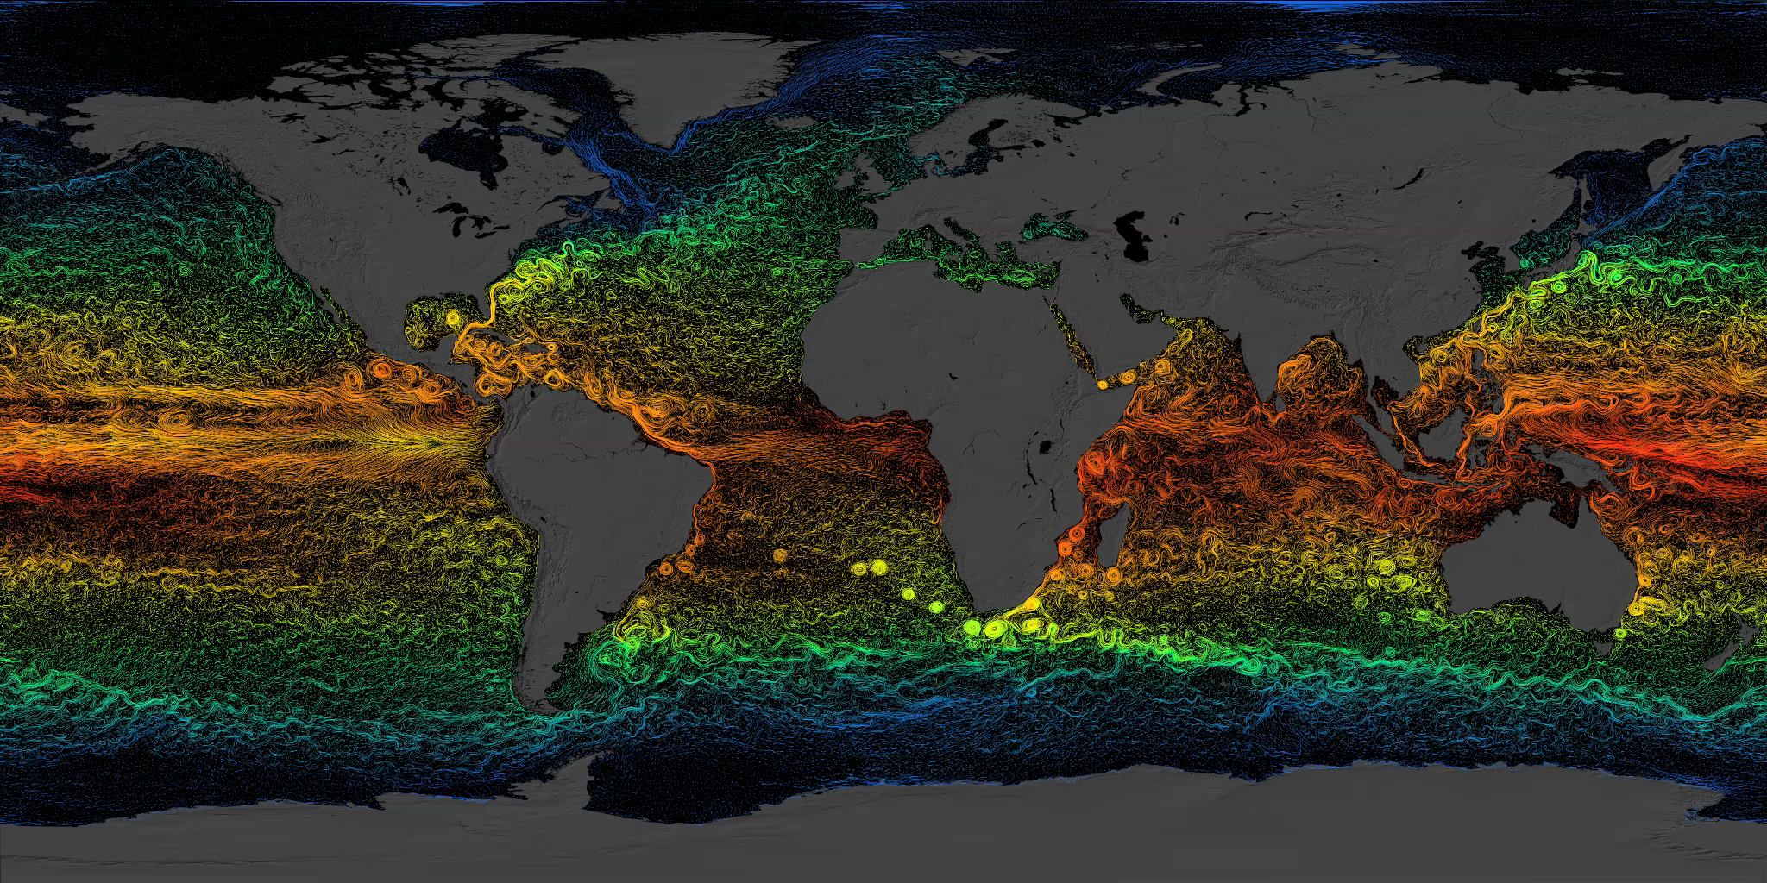
But this is what the World Ocean looks like.
Complex Circulation defines the Ocean Gyres

Slide 19
How can we use data in teaching?
Notes:
This is important – many different groups (K-12, informal, research institutions, data visualization people, software developers, etc., use the term differently. It is used differently in scientific literature versus educational literature. There is no “official” definition of data. In order to cover the wide variety of information we work with in informal environments, we define data very broadly.

Slide 20
What Do Educators Want?
Top requested features:
Data visualization tools (ability to graph, map, chart data)
Inquiry-based lessons/activities
Lesson plans for teaching science concepts with RTD
Locally relevant data sets
Map interfaces
Stories or case studies that show how scientists use real-time data.
Middle-school teachers were more likely to have students use:
Computers at school as part of their lessons
The Internet/websites at school as part of their lessons
Real-time data (mostly student-collected data) as part of their lessons
NERRS Real-Time Data Needs Assessment 2006
COSEE NOW Educator Survey 2008
Notes:
Educator Survey:
Q3: What characteristics are important when you teach using RTD? Data presented visually 4.3 (#3/11)
Q8: What RTD related activities are you likely to engage in? Finding data in visual formats 73%
This study’s results show a gap between stakeholders’ views that high-school should be the primary target and teachers’ and other data that indicate that middle-school would be the better primary target, especially for NERRS. Although more high-school teachers attended the focus groups than middle-school teachers (56% vs. 43% respectively), in comparing the two groups’ responses to the online survey we found that middle-school teachers were more likely to:
have student use computers at school as part of their lessons
have students use the Internet/websites at school as part of their lessons
have students use real-time data (mostly student-collected data) as part of their lessons (see the full report).
Main point: middle school students are more likely to collect their own data, while high school students will spend more time on data analysis.

Slide 21
Visualization Tool Design Philosophy
Simple
Intuitive & easy to use
Interactive
To support deeper understanding
Customizable
Adaptable to fit your learning goals
Embeddable
Place content in context within your lessons
Focused
Learning outcome driven, not data driven – these are not your typical comprehensive data visualization tools
Educational
Primary goal is to aid students’ analysis and understanding of scientific processes, not dealing with data formats and graphing

Slide 22
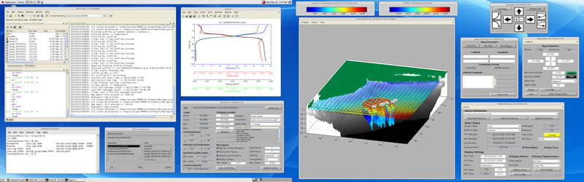
A Scientist’s Visualization/Analysis Tool
Audience Needs: Raw data, Advanced viz & processing tools
Challenges: Storage, Processing power, Metadata, Flexibility
Notes:
At each level, what is the audience and the challenge to visualization?
For example, how does a scientists read and use data?

Slide 23
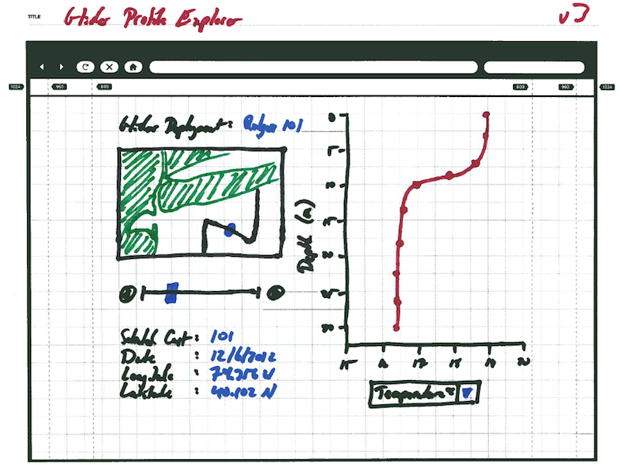
An Educator’s Visualization Tool
Driving Questions:
This tool will allow students to analyze single glider profiles (also called casts) to investigate the following questions:
How do measurements vary over the depth of the water column?
How does the shape of a particular measurement's profile vary over time and/or location?
Notes:
At each level, what is the audience and the challenge to visualization?
For example, how does a scientists read and use data?

Slide 24
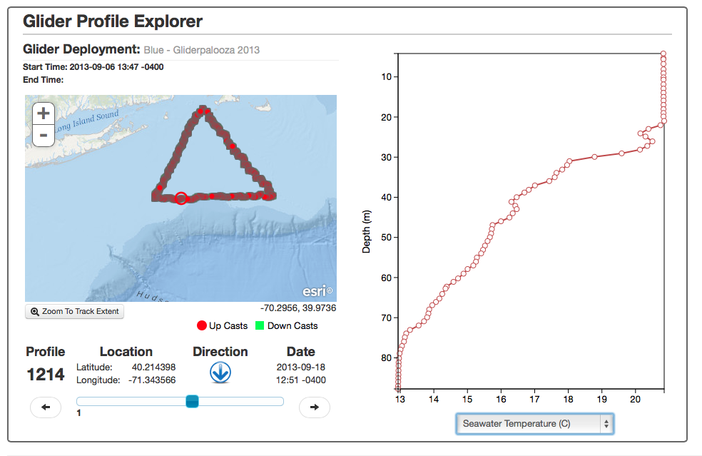
Glider Profile Explorer

Slide 25
Learning Sciences Theory
Visualization for Learners
Inquiry-based learning units must include:
Motivating context
Learner-appropriate activities
Appropriate datasets
Scaffolding interfaces
Support for learning
(Edelson & Gordin 1998)
Learning-for-Use
Motivation
Experience demand
Experience curiosity
Knowledge Construction
Observe
Receive communication
Knowledge Refinement
Apply
Reflect
(Edelson 2001)

Slide 26
Design Frameworks: Learning for Use (Edelson, 2001)
For each target goal:
Motivate: beyond the hook, this is creating a need to know. Create demand/elicit curiosity
Construct: provide opportunities for learners to construct the objective understandings (this is where scaffolding comes in)
Refine/Apply: provide learners with opportunities to use the knowledge and reflect on it, thus refining it.

Slide 27
Summary of Design Process for DIB
Backwards Design:
1. Begin with goals- what are the knowledge and skills you want individuals to develop
Learning for Use:
2. Think about motivating problem or project (contextualize)
3. Define the backbone – the main sequence of events
4. Develop activities within the backbone
Don’t tell the answer, have learners figure it out – they learn goals in context of project
5. Provide opportunity to apply knowledge (culminating task)

Slide 28
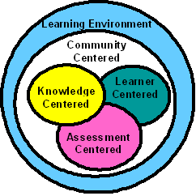
Learning Sciences
Building theory in education through the design and empirical testing of learning environments that are:
Knowledge centered
Learner centered
Assessment centered
Situated within a learning community
NRC: How People Learn (Bransford, Brown & Cocking, 1999)

Slide 29
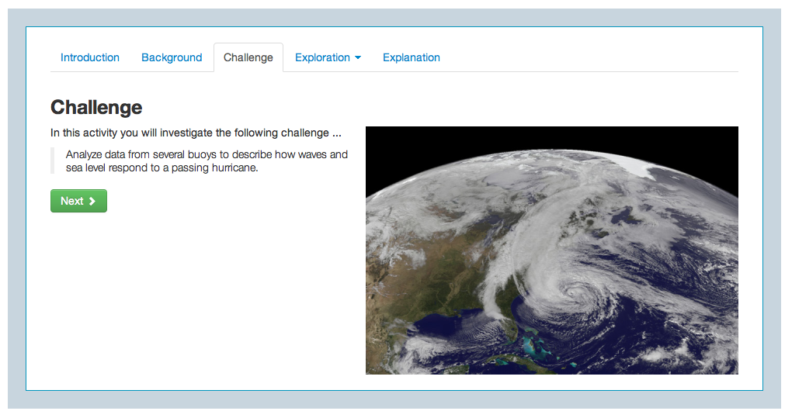
Knowledge Centered
Inquiry-based and organized around questions/problems
Data driven activities.
Investigations conclude with the development of a scientific explanation
Mirrors scientific practice
(Duschl, 1990; Donovan & Bransford, 2005)

Slide 30
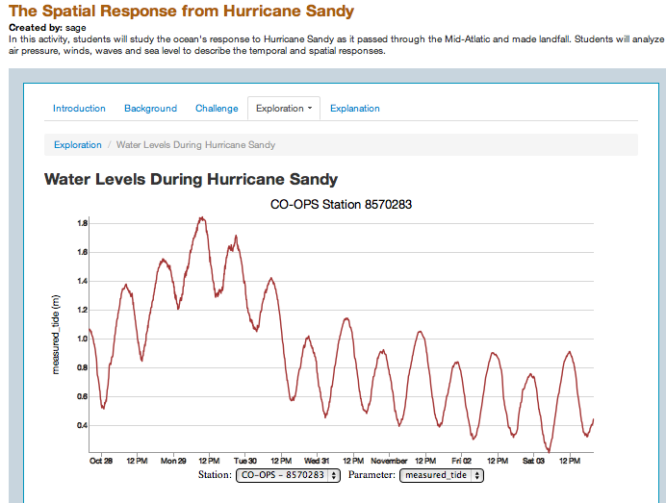
Student Centered
Initial questions serve to surface students‘prior knowledge
Investigation help students build understandings of the core concepts
There are opportunities to reflect on learning and compare initial ideas to final ideas
Surface, build, and revise ideas (Driver et al., 1996; Ford & Forman, 2006)

Slide 31
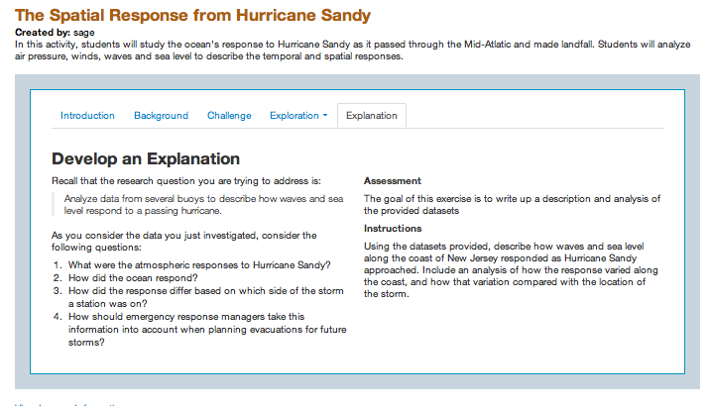
Assessment Centered
Formative assessment is critical for learning
Supports professors in tailoring instruction to meet students’ needs
Make thinking visible
(Black & Wiliam, 1998; Bransford, Brown & Cocking, 2000)

Slide 32
How does this fit into Criterion 2?
Develop a Data Investigation for your students and share with the community.
Develop a new Educational Visualization Tool that others can work with.
Develop and share rich concept maps (e.g. with photos, videos and more) that help explain your research.
Develop and share other educational resources (lesson plans, student research ideas, outreach stories etc.) for formal or informal audiences.

Slide 33
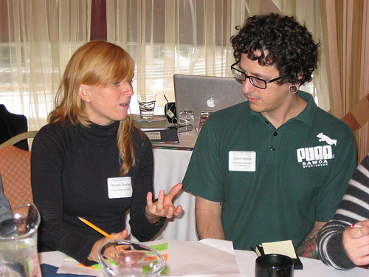
Student Argumentation Skills…
focused on analyzing evidence and backing up their claims. The ability to make and understand scientific claims, analyze evidence, and develop arguments from the analysis of data is critical to student learning success and to compete in the modern workforce.

Slide 34
Teaching with Data - Questions
In what contexts do you (would you) use RTD in your teaching?
How do you present data to your students? What data formats and contextual lead-ins do you provide?
If you were to ask your students to investigate a data set in class and/or as homework how would do so, how would you prepare them?
How much time do you spend on graph making and reading vs. analysis? How do you prioritize these efforts?

